Slide 1
Allstate Exercise

Slide 2
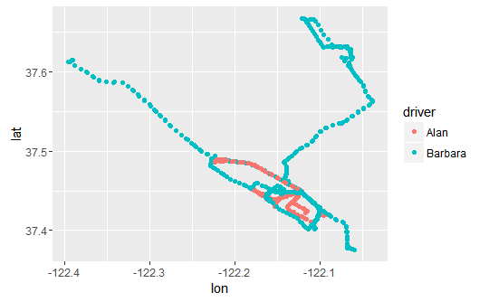
Coordinate (lon and lan)
Driver | Coordinate | Mean
Alan | longitude | -122.2
Barbara | longitude | -122.1
Alan | latitude | 37.45
Barbara | latitude | 37.48
Both drivers are driving in a same area or city
Barbara is driving in a wider area than Alan

Slide 3
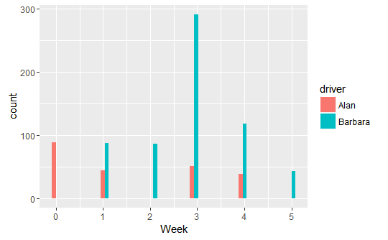
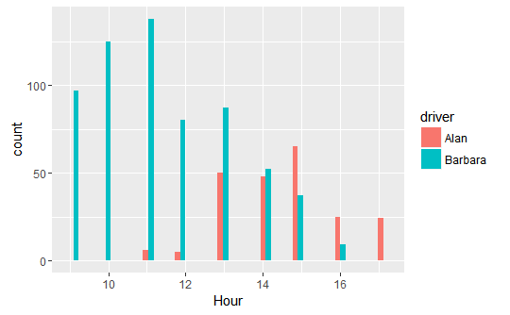
Date
Alan's records are sampled from 2009-4-5 to 2009-5-3
Barbara's records are sampled from 2009-4-13 to 2009-5-7
Data are sampled in the same area and the same period of time for both drivers
Barbara is driving 5 days in a week while Alan is driving 4 days in a week
Barbara is mostly driving in the morning while Alan is driving in the afternoon

Slide 4
Speed and Acceleration
Driver | Mean Speed
Alan | 27.94
Barbara | 29.81
In average Barbara is driving faster
Based on the speed Alan is the safer driver
Driver | Exceed the acceleration threshold (%)
Alan | 17.9%
Barbara | 2.4%
Alan exceeds the acceleration threshold more than Barbara

Slide 5
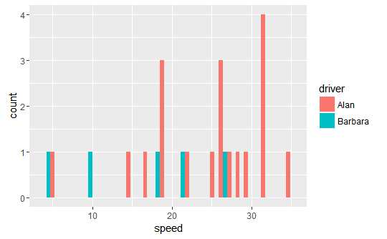
Acceleration at non zero speed
I exclude speed 0 from my calculation
Driver | Exceed the acceleration threshold excluded speed 0 (%)
Alan | 11%
Barbara | 0.9%
Alan exceeds the acceleration threshold at high speed more than Barbara
Based on the acceleration Barbara is the safer driver

Slide 6
New variable
Distance between start and end of a trip
Average distance in each trip
Driver | Distance (m)
Alan | 411
Barbara | 612
In average Barbara is driving longer distances than Alan
Sum of all distances
Driver | Distance (m)
Alan | 80712
Barbara | 245147
In total Barbara is driving more than Alan

Slide 7
Who is the safer driver?
Barbara is driving longer distances with high speed and low acceleration
Alan is driving shorter distances with low speed and high acceleration
I think speed and distance are more important than acceleration
Alan is the safer driver
we need more information for accurate prediction. For example, speed limit would be very helpful

Slide 8
Between the trip 7, driven by Allen, and 13, driven by Barbara, who drove on the highway?
Average Instantaneous speed
Driver | Speed
Alan | 32.62
Barbara | 11.33
Average speed = distance / time
Driver | Speed (meter/minute)
Alan | 900
Barbara | 330
Alan is driving faster. He is probably driving on a highway

Slide 9
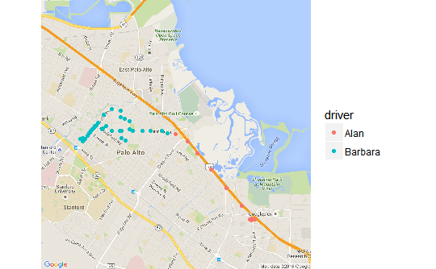
Between the trip 7, driven by Allen, and 13, driven by Barbara, who drove on the highway?

